Slide 1
North Yorkshire Safeguarding Adults Board
Update November 2024

Slide 2
Annual Report Overview
Full report available: NYSAB
Full report here:
NYSAB

Slide 3
NYSAB Board Development Day
Co-production of mission, vision and strategic plan
Board
Public
Providers
Wider Families
Mission
Partner CEO’s
Carers
Workforce
People with Care and Support Needs
Move towards: Communication, Prevention and Confident Practice

Slide 4
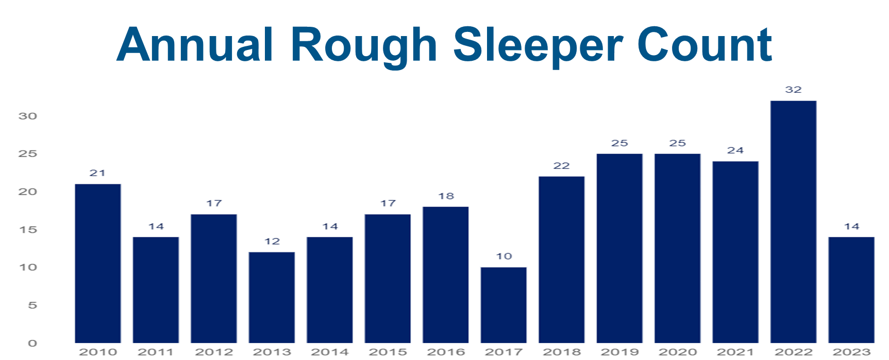
NYSAB Board Development Day
Presentations from:
North Yorkshire Police
Health and Adult Services
Rough Sleeper team – M Gibson
Public Health Team – Louise Wallace
Humber and North Yorkshire ICB
Housing

Slide 5
Community First Yorkshire Update
Safeguarding is Everyone’s Responsibility
Highlighting the need for easy access to free and appropriate Level 2/3 training for volunteers outside NHS/Social Care.
Self-assessment checklist (with Hambleton Community Action ) Checklist
Emergency response toolkit
Revised safeguarding policy template at final review stage
Evaluation of Safeguarding Week 2024 activity
Safeguarding audits offered to community anchor organisations
Safeguarding policy reviews for any North Yorkshire VCSE organisations
Links to Hate Crime Awareness and Prevent teams
Hate crime | North Yorkshire Police
Prevent | North Yorkshire Partnerships

Slide 6
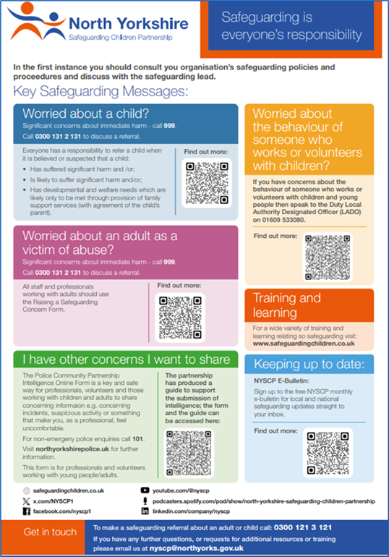
Safeguarding Training
NYSAB Find Training
NYSCP Find training
Safeguarding - Community Support North Yorkshire
Safeguarding Toolkit- Community Support North Yorkshire
Prevent Training 2025

Slide 7
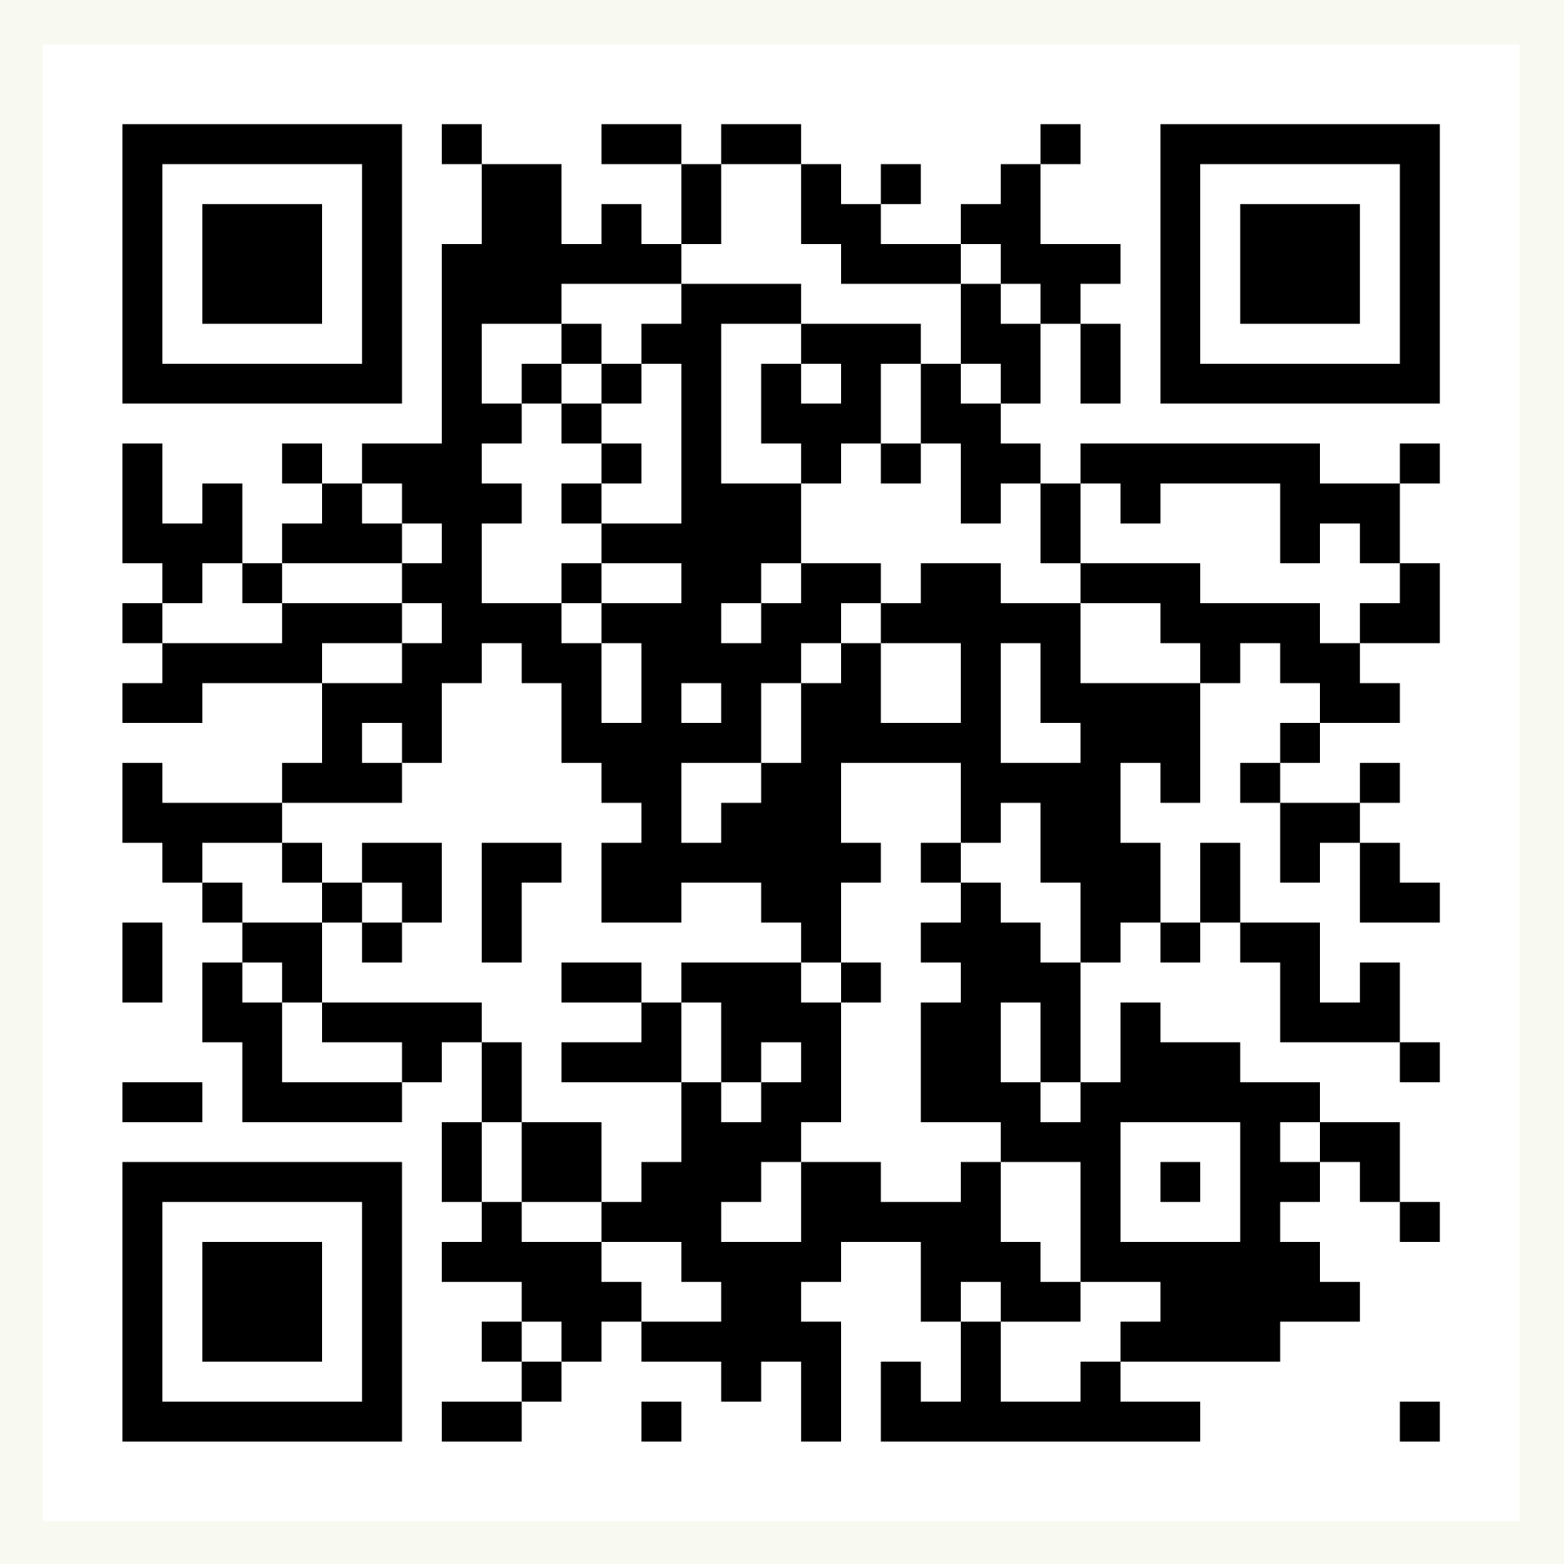
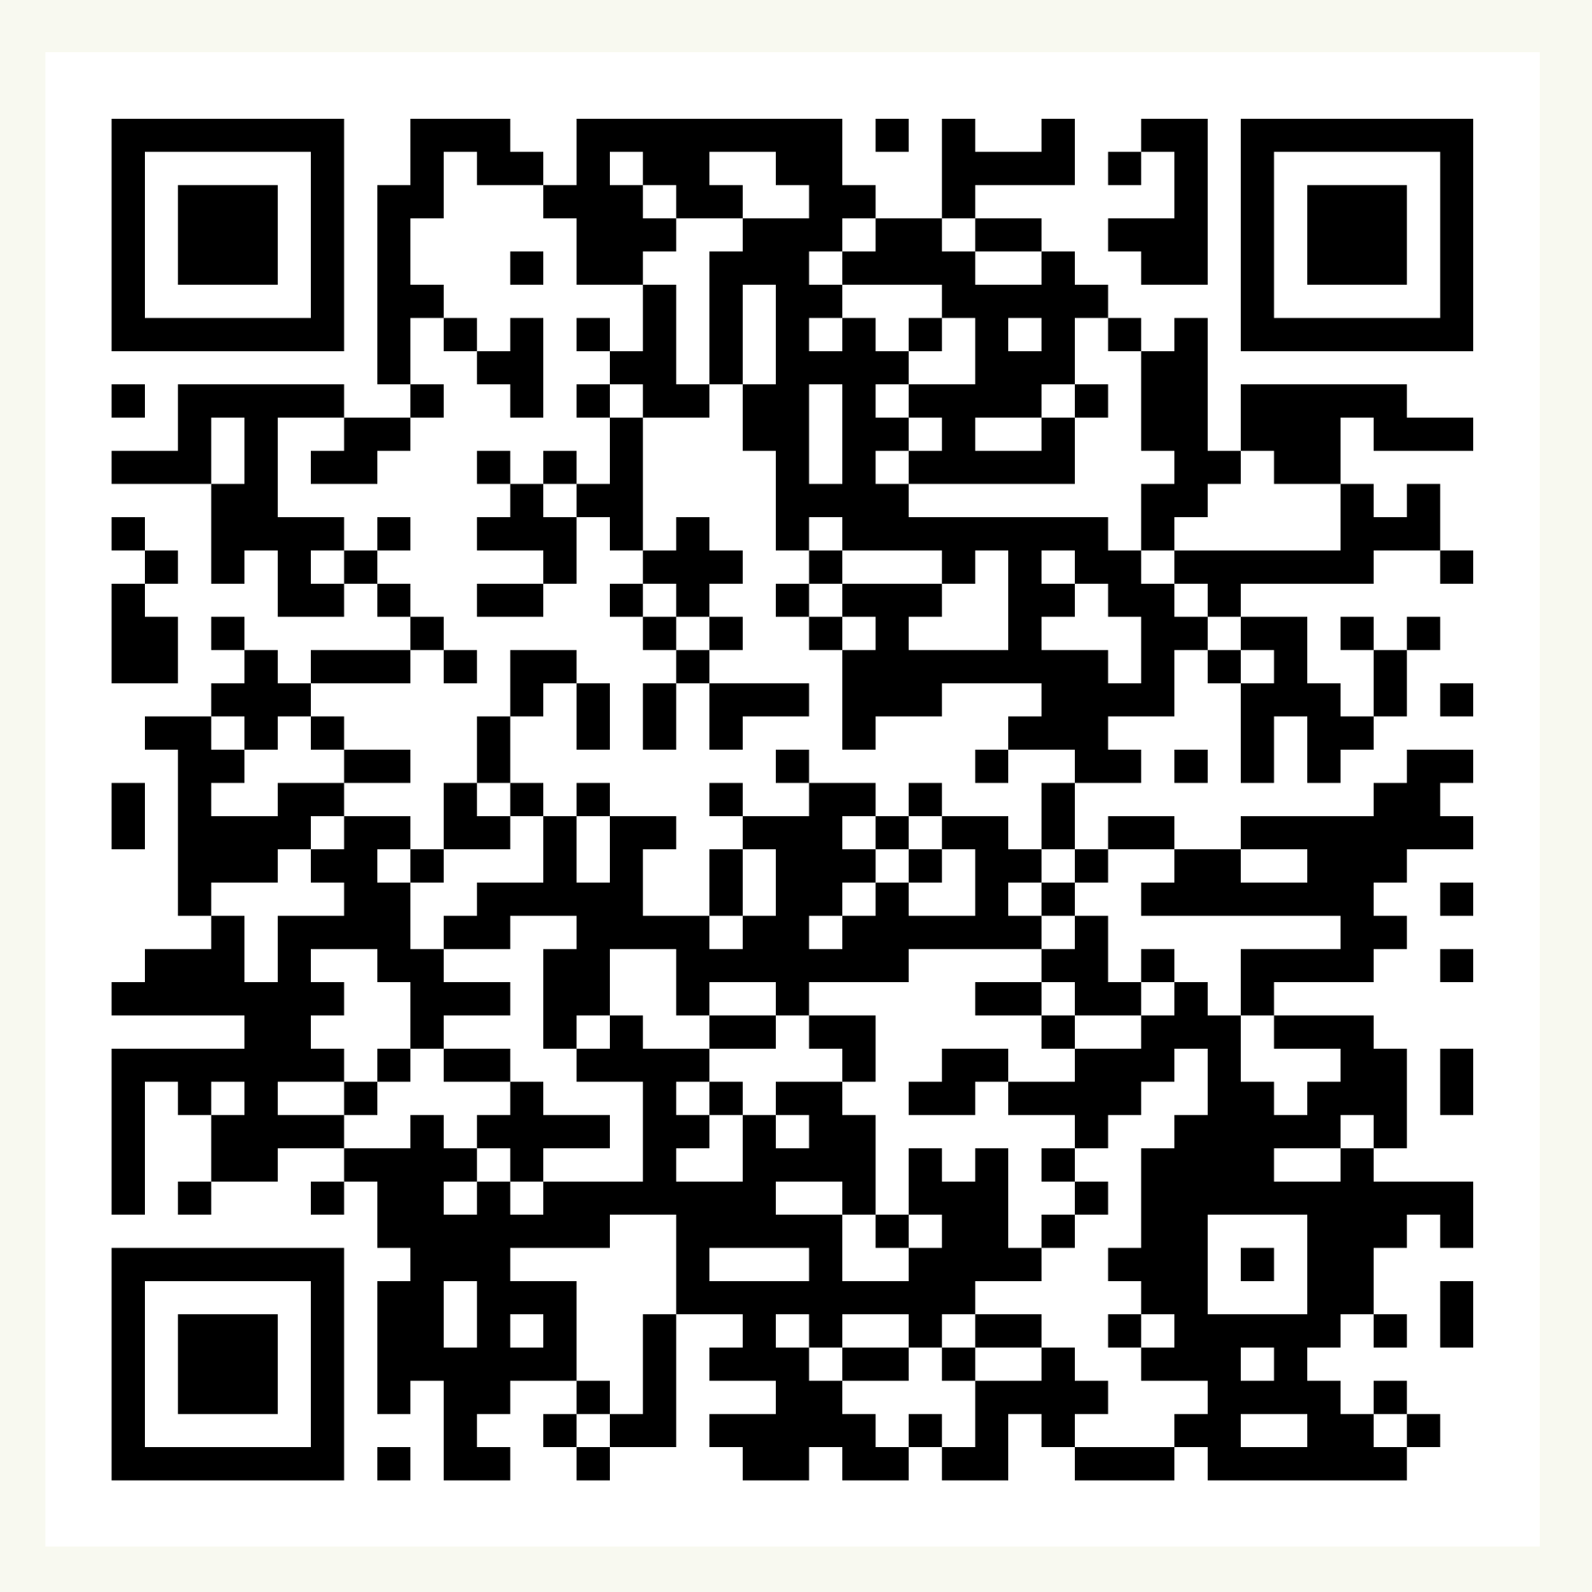
Thank you!
For further support:
Contact us at:
communitysupport@communityfirstyorkshire.org.uk
Sign up for our funding portal here:
Sign up to receive our newsletters here:
Notes:
We hope that has given you a flavour of our work and a clear picture of how and why we do what we do.
We are open to questions!
We would like to work with you in the following ways:
Different level cases – case studies, autism strategy, parish council examples, priority groups, diverse communities
Training etc
Campaigns and content
Working with external partners
Would be useful to have similar info from Localities teams
Can complete a FAQ

